Slide 1


Meet mr. abbas
1
Notes:
Nick: “Everyone say hello to a special friend of ours, Mr. Abbas, a businessman from the UAE. In his free time he loves to travel around the world. This month, Mr.. Abbas is planning on taking his semi-annual leisure trip. He has chosen London as his destination. Mr.. Abbas is hoping this trip is more successful than his last, a trip to Russia that ended up rushing him home with nothing but a matryoshka doll from the duty free and a tear in his eye.“

Slide 2
Travel document issues: travelers
Required documents for some destinations are extensive and strict
Travelers from some countries face extra scrutiny or require more travel documents
2012: People denied U.S. visas due to applications that did not comply with regulations:
105,677
Denied on second attempt: 35,930
2
Notes:
Kevin: “International travel is a burdensome process due to required travel documents. It is more burdensome for travelers from certain countries traveling to certain other countries. Improper applications can result in canceled trips; carrying improper documents can cause people to be denied entry on arrival.”

Slide 3

Meet Fahim
3
Notes:
Nick: “Let’s meet Fahim, Mr. Abbas’ local travel agent. Fahim is one of the thousands of agents working in mid-size agencies in the Middle East. Fahim’s knows that ancillaries such as travel documents are a great way for him to make extra revenue and provide a higher level of service to his customers. Fahim has been using a large back office staff and printed reference books to figure out the documents his travelers need, but it’s not fast and very time consuming.“

Slide 4
Travel document issues: agencies
Travelers in some regions rely on agencies for information on travel documents, and processing of those documents
Travel agencies make 30% of their revenue on ancillary services
Agency Challenges and Opportunities:
  Document requirements can change quickly
  Processing travel documents adds value – another ancillary service
4
Notes:
Kevin: “Agents sometimes collect and process travel documents for travelers, but that is outside their normal workflow and workspace. However, document services add to an agency’s bottom line, and it is a way to further engage the customer, build trust, and improve stickiness. How can Sabre help travelers and agencies with these issues?”

Slide 5




DOSSIER
Notes:
Annie: “Introducing DOSSIER. It reduces agents’ workloads by using IATA’s Travel Information Manual database to determine the documents the traveler needs.“

Slide 6
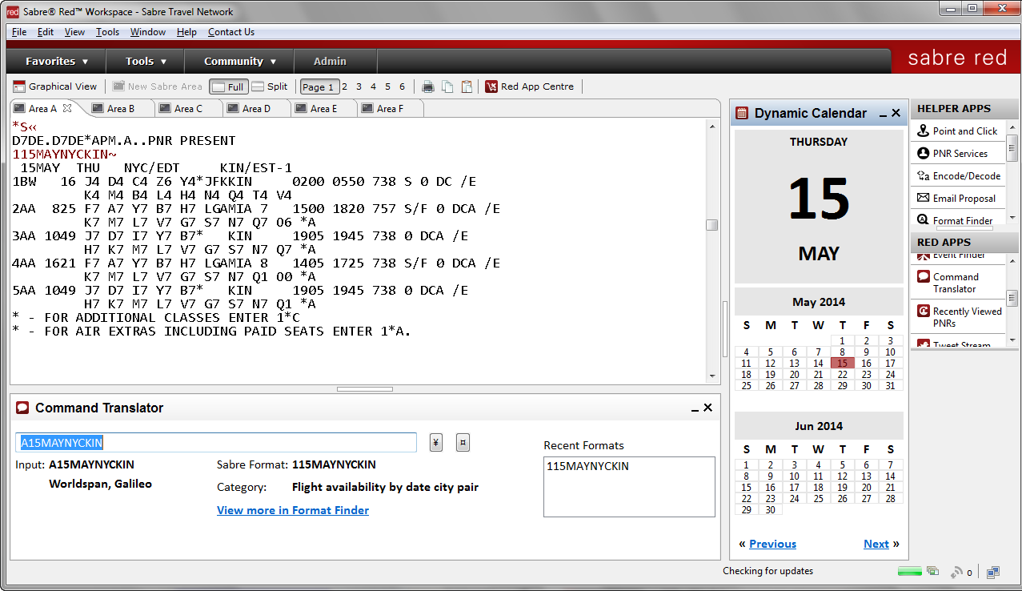

Traveler screen
DOSSIER
v.1.0
App Info
ABBAS\ABDULLAH
1. Traveler
PNR:
United Arab Emirates
2. Itinerary
Nationality:
Country of Birth:
United Arab Emirates
3. Customs
Residence Country:
United Arab Emirates
4. Summary
Date of Birth:
10
08
1970
Email
Document Held:
Passport: Normal
Issuing Country:
Passport: Normal
Save as Text
Expiry Date:
12
31
2015
Save as RTF
Document Feature:
(none)
Next
Traveler info can be pulled from a PNR, or entered manually
Uses the IATA TIMATIC database for information
6
Notes:
Kevin: “We move part of the travel document process into the agent’s workflow so they can stay in the GDS – that improves agent efficiency, and expands Sabre’s ecosystem. Note that DOSSIER is an information aggregator; it provides the agent with a list of documents that they or the traveler must gather. (We’ll discuss scaling up DOSSIER’s capabilities later.) The Traveler screen shows the traveler’s personal and held document information.”

Slide 7
Itinerary screen
DOSSIER
v.1.0
App Info
LHR
1. Traveler
Destination/Airport:
or
AUH
2. Itinerary
Departure/Airport:
or
3. Customs
Arrival Date:
10
30
2014
4. Summary
Duration:
14
Days
Purpose:
Business
Email
Transit Point 1:
or
Save as Text
Transit Point 2:
or
Save as RTF
Transit Point 3:
or
Back
Next
Itinerary info can also be pulled from a PNR, or entered manually
Multiple transit points can be selected
7
Notes:
Kevin: “The Itinerary screen shows the traveler’s destinations. The agent can enter the information manually if it is not pulled from a PNR (that is true for all screens on the app).“

Slide 8
Customs screen
DOSSIER
v.1.0
App Info
United Kingdom
1. Traveler
Customs Info 1:
or
Customs Info 2:
2. Itinerary
or
Customs Info 3:
or
3. Customs
Currency Info 1:
United Kingdom
or
4. Summary
Currency Info 2:
or
Email
Currency Info 3:
or
Export Info 1:
United Kingdom
or
Save as Text
Export Info 2:
or
Save as RTF
Export Info 3:
or
Back
Next
Customs, currency, and export info for up to three destinations
Can use country names or airport codes
8
Notes:
Kevin: “The Customs screen provides the agent with customs, currency, and export info for up to three destinations.”

Slide 9
SUMMARY screen
DOSSIER
v.1.0
App Info
Summary
Conditional: The traveler will need to hold travel documents as detailed below.
Passport OK. Additional information:
Flights between the United Kingdom and the Channel Islands, Ireland (Rep.) and Isle of Man are treated as domestic flights, therefore are not subject to UK immigration control.
Visa Required.
The following are exempt from holding a visa:
A max. stay of 6 months for nationals of United Arab Emirates holding a printed Electronic Visa Waiver (EVW). Period of stay will be determined by Immigration Officer on arrival.
Important:
The Electronic Visa Waiver (EVW) issued to nationals of United Arab Emirates must:
- be submitted online via https://www.visa4uk.fco.gov.uk/ , at least 48 hours but less than 3 months prior to travel;
1. Traveler
2. Itinerary
3. Customs
4. Summary
Email
Save as Text
Save as RTF
Back
Start Over
The summary can be saved as a text file or an RTF file
The agent may also send the summary as an email
9
Notes:
Kevin: “On the Summary screen, the agent can email the document information to the traveler via the agent’s email client application. Or, the agent can export the summary as plain text or in rich text format. DOSSIER makes a complex task simple, improves the agent’s efficiency, and keeps the agent in the Sabre workflow and ecosystem.“

Slide 10


FahIM uses
DOSSIER
10
Notes:
Nick: Paraphrased Narration: “Mr. Abbas trusts face-to-face travel agents over online agencies. Fahim can serve more customers per day with the time he saves using DOSSIER. And Mr. Abbas is very satisfied with the service he’s received.”

Slide 11
Launch market: middle east
An opportunity market
Middle Eastern travel agencies
Most travelers prefer storefront travel agencies over OTAs
Middle East Broadband Access
  Households with fixed broadband: 17.1%
  Households with mobile 3G or 4G: 22.2%
11
Notes:
Annie: “Why did we choose the Middle East? It is the fastest-growing travel market in the world. Sabre is investing in the Middle East; we just opened an office in Turkey. And there are *a lot* of travel document issues in the Middle East. Most travelers in the region prefer local travel agencies over OTAs; trust, experience, and a cash economy contribute to that preference. And broadband access is low, so OTAs are not often a viable option.”

Slide 12
Agent AND traveler benefits
Middle East agencies benefit from DOSSIER
  Accelerate document confirmation and processing
  Cut costs with less staff, or can use staff more efficiently
  Improve satisfaction and retention (stickiness)
Middle East travelers benefit from DOSSIER
  Receive accurate, current information on travel documents
  Gain lead time in case of problems
  Collect documents in advance of deadlines
12
Notes:
Annie: “DOSSIER makes agencies more efficient, saving up to 80% of the time now required to process documents. It helps agencies optimize their overhead by efficiently using their people. It mitigates the risks involved with providing incorrect travel documents. And, it allows agencies to be ultra-engaged with the traveler.”

Slide 13


everyone wins with
DOSSIER
13
Notes:
Nick: Paraphrased Narration: “Mr. Abbas enjoys his Tower of London tour, and Fahim makes a lot of money using DOSSIER.”

Slide 14
An OPPORTUNITY for sabre
Flat market share of 25% of all ME GDS bookings
ME travel market growing at 5% per year
Booking fee: $6.52/booking
Subscription fee: $350/year
14
Notes:
Liujia: “DOSSIER’s improvement in agent or staff efficiency helps Sabre. Thanks to the extra bookings agencies can make using DOSSIER, we project that the app will generate an additional $116,000 in revenue for Sabre in the first year.”

Slide 15
Cost projections
IATA TIMATIC Fixed Fee:
$130,000
Assumed incentive fee:
$2.50 per booking
Development hours:
300 at $68.35 (blended rate)
Maintenance: 12% of development cost
15
Notes:
Liujia: So, what will DOSSIER cost to develop? Using a middle estimate for time, and a blended onshore-offshore development model, the development cost is very reasonable. The largest expense is for access to the TIMATIC database. Expenses are tied to revenues as expenses increase with bookings.

Slide 16
Revenue projections
Free cash flow breaks positive by Q2 2016
EBITDA breaks positive Q1 2016
Net present value: Five-year NPV $1.2 million
16
Notes:
Liujia: We assumed our ¼ to 1/3 of our over 1,400 agencies in the Middle East will adopt DOSSIER on a standard Rogers curve – a bell curve of time to adopt a new technology. Using those numbers, we priced DOSSIER at $350 a year, a price that is very competitive with IATA’s print offering, and well below their web offering. We estimate this will make DOSSIER profitable by the end of 2016. The FCF very closely follows the product lifecycle curve.

Slide 17




scalability
Document downloads
Third-party expediters
Additional markets
17
Notes:
Annie: DOSSIER has excellent scalability. Markets similar to the Middle East exist in Africa, Eastern Europe, and Asia – but DOSSIER can also be expanded to any market. We can also integrate downloads for documents, such as business introduction letters.

Slide 18
Questions and answers
DOSSIER
18
Notes:
Kevin: “Are there any questions from the panel?”

Slide 19

Questions and answers
Very special thanks to our team mentors:
Ashley Bynum Adam Gainey
Kate Feller Matt Swinton
Thanks to our SMEs, who graciously assisted us:
Alan Baumgarten
Randal Beasley
Steve Chomik
Charles Comar
Gerry Davis
Joe Dyer
Joakim Everstin
Christen Garcia
Steve Gillon
Kristen Jarmon
Julian Macagno
Alex Meneghello
Michael Minor
Kyle Moore
Jenna Pieschel
Tim Powell
Jenna Reynolds
Emily Stafford
Jane Strauss
Peter Terrana
Joanna Thompson
Emma Wilson
19

Slide 20
APPENDIX
DOSSIER

Slide 21
Sensitivity analysis

Slide 22
Labor matrix
2014 Labor Rates
  Onshore Rate: $106.17
  Offshore Rate: $34.46
  Blended Rate: $68.35
2015 Labor Rates
  Growth rate: 4%
  Onshore Rate: $110.42
  Offshore Rate: $35.84
  Blended Rate: $71.08
Utilization
  Oct 2014: 139 hours
  Nov 2014: 168 hours
  Dec 2014 108 hours
  Jan 2015: 126 hours

Slide 23
Incremental bookings
11

Slide 24
Competing offerings
Value: Price and Performance vs. IATA Products
TIMATIC books: $340/year
TIMATIC2 Web: $670/year
  500 transactions included
  $0.17/transaction to 100,000
Better value and integration
Notes:
KEVIN: How they’ll buy, how much we’ll make

